Slide 1
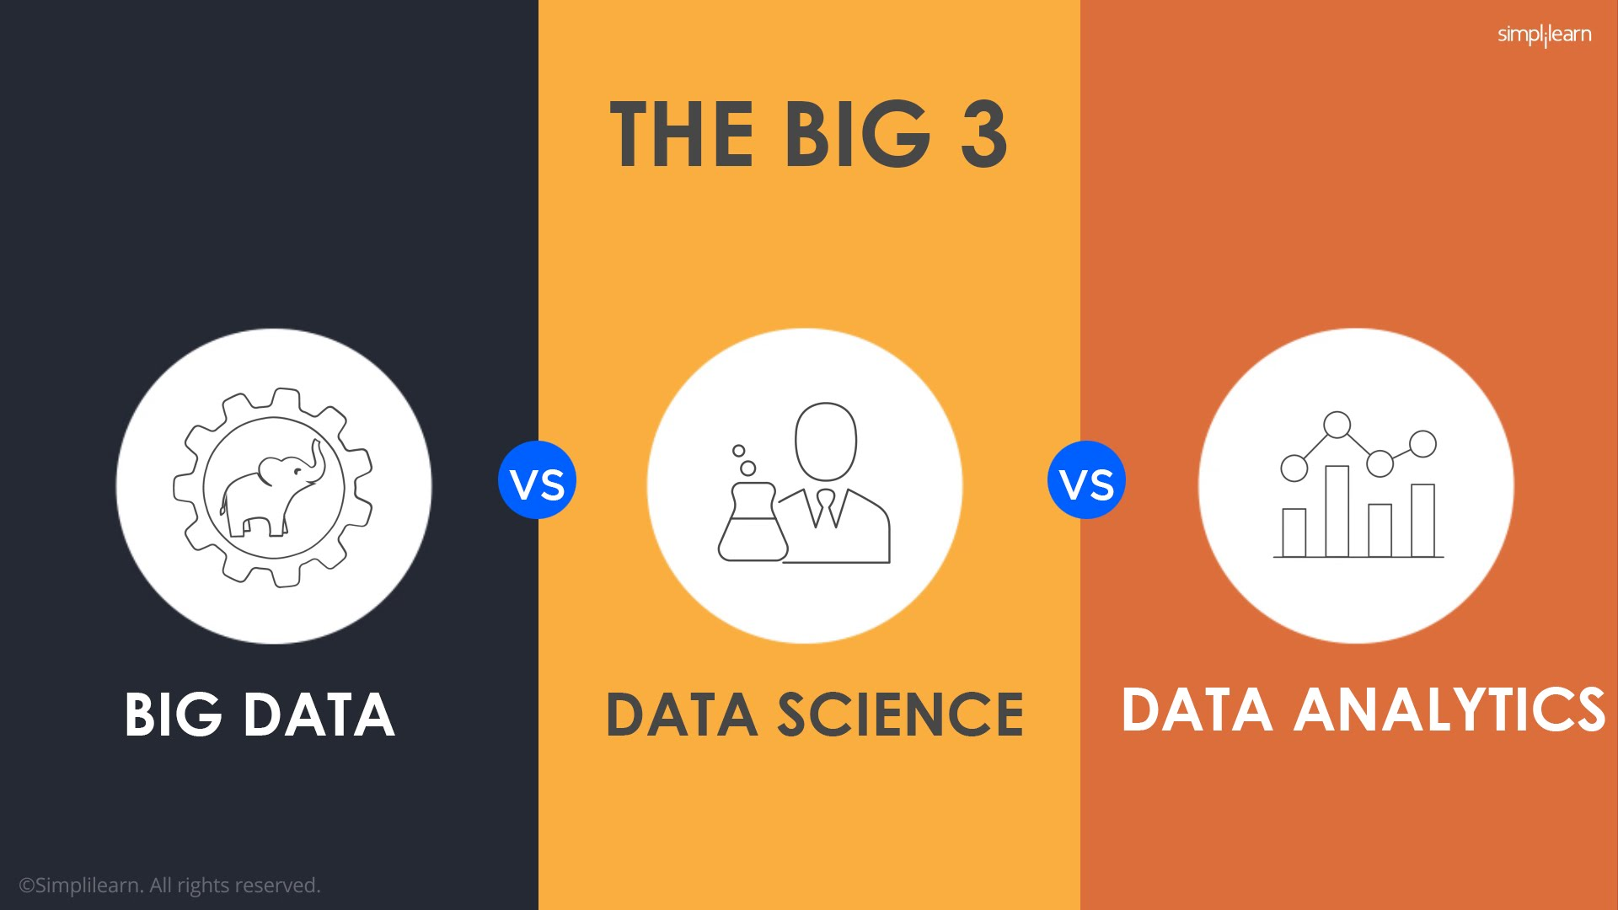
INTRODUCTION TO DATA SCIENCE!

Slide 2
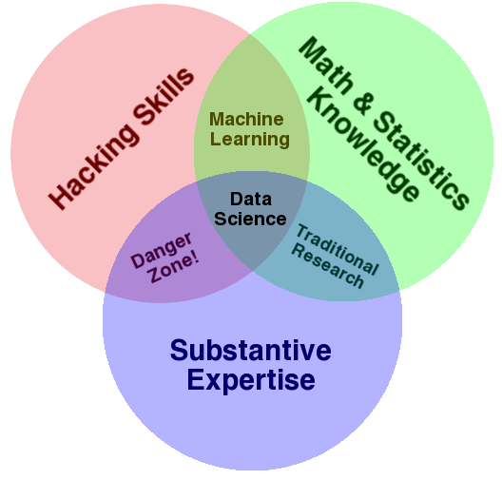
WHAT IS DATA SCIENCE
Data Science aims to derive knowledge from big data, efficiently and intelligently”
Data Science encompasses the set of activities, tools, and methods that enable data-driven activities in science, business, medicine, and government
Data Science Venn Diagram
Notes:
Useful skill
Important tool
Window into corners of everyday life

Slide 3
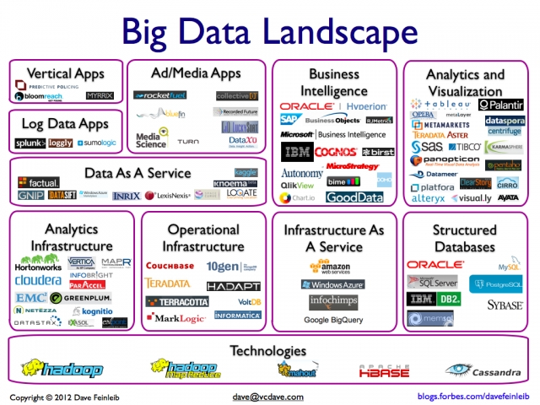
the companies are expanding as fast as the data!
Notes:
http://www.cs.ucl.ac.uk/staff/D.Jones/t42morph.html
This animated GIF image shows a synthetic folding trajectory for a small alpha-helical protein (porcine NK-lysin) which was predicted using our FRAGFOLD software as part of the 2nd CASP experiment carried out in 1996. This was the first successful prediction of a novel protein fold in CASP and was also notable as being the first fold prediction method to employ fragment assembly. The basic idea of fragment assembly is to take fragments of already known protein structures and to recombine them randomly to create possible new protein folds. See the following reference for more details:Jones, D.T. (1997) Successful ab initio prediction of the tertiary structure of NK-Lysin using multiple sequences and recognized supersecondary structural motifs. PROTEINS. Suppl. 1, 185-191.

Slide 4
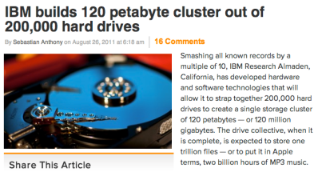
Data, data everywhere…
There's certainly a lot of it!
1 Zettabyte
1.8 ZB
8.0 ZB
800 EB
Data produced each year
logarithmic scale
161 EB
1 Exabyte
5 EB
120 PB
100-years of HD video + audio
1 Petabyte
Human brain's capacity
60 PB
2002
2006
2009
2011
2015
14 PB
1 Petabyte == 1000 TB
1 TB = 1000 GB

Slide 5
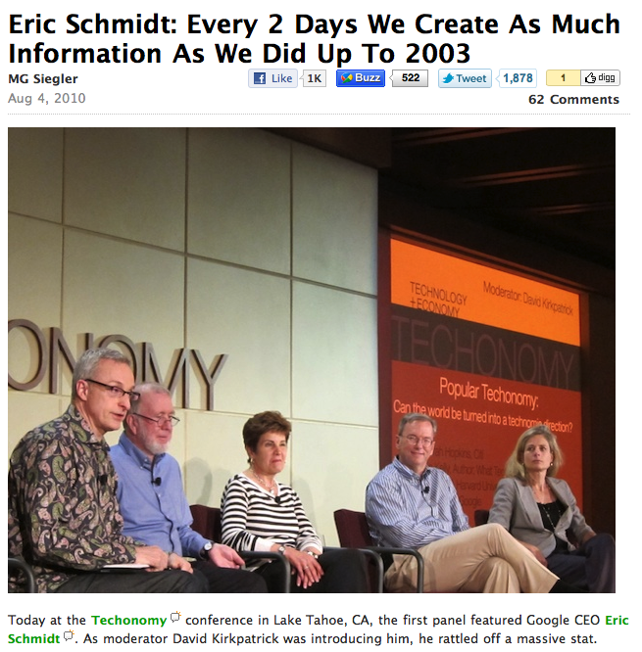
I'd call it data, not information
wisdom
knowledge
information
data
Notes:
Electric: from www.staticfreesoftware.com
My tutorial is at:
http://odin.ac.hmc.edu/~harris/class/chipdesign/electric.pdf
Lasergene (a molecular biology suite of programs for aligning and comparing
DNA sequences, etc.)
Statview (statistical analysis)
KaleidaGraph (plotting & graphing)
Populus (programs that simulate ecological and evolutionary processes)

Slide 6
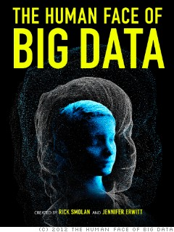
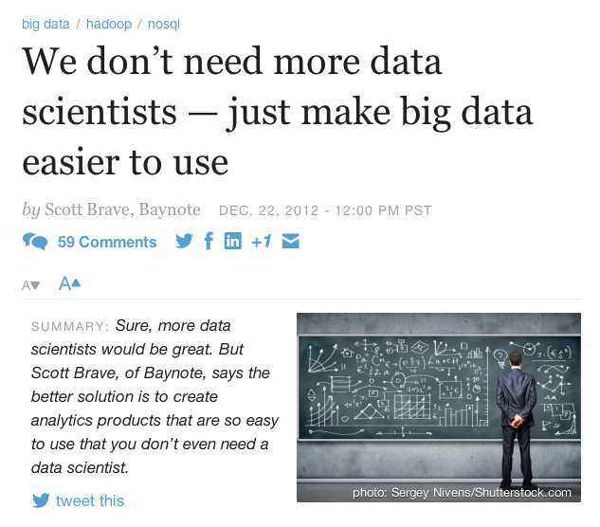
Big Data
Notes:
Useful skill
Important tool
Window into corners of everyday life

Slide 7
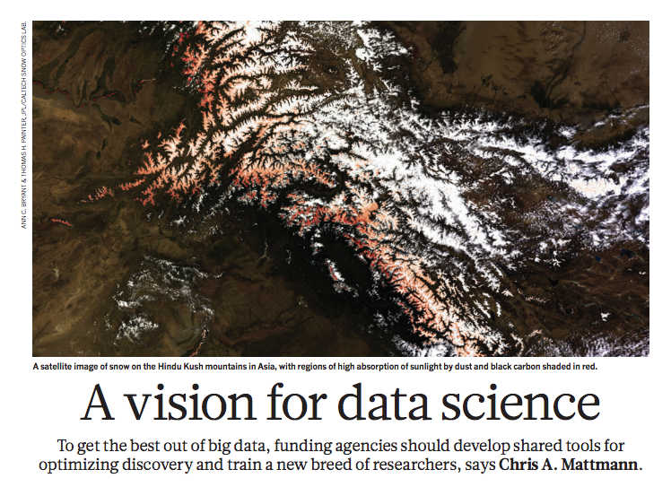
Make data easier to use ~ by using it!
It may be true that Data Science isn't a science – but that doesn't mean it's not useful!
Notes:
Useful skill
Important tool
Window into corners of everyday life

Slide 8
What?
Why?
Data Science Programming
Data Rules
All of our insights – large and small, permanent and ephemeral, natural and artificial – come about through the integration of lots of data.
Data Science simply recognizes that the rules and skills behind those insights are widely applicable…
Notes:
Useful skill
Important tool
Window into corners of everyday life

Slide 9
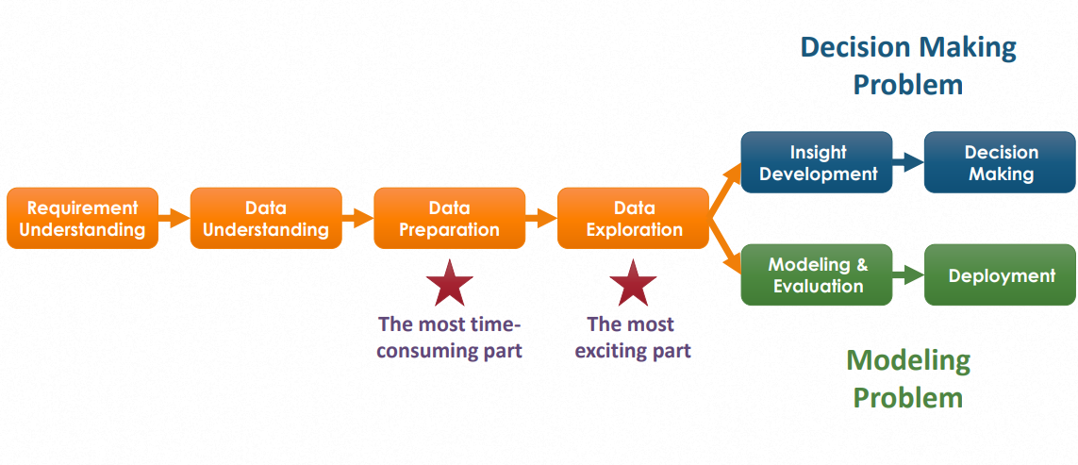
STEPS FOR PROCESSING ANY DATA

Slide 10
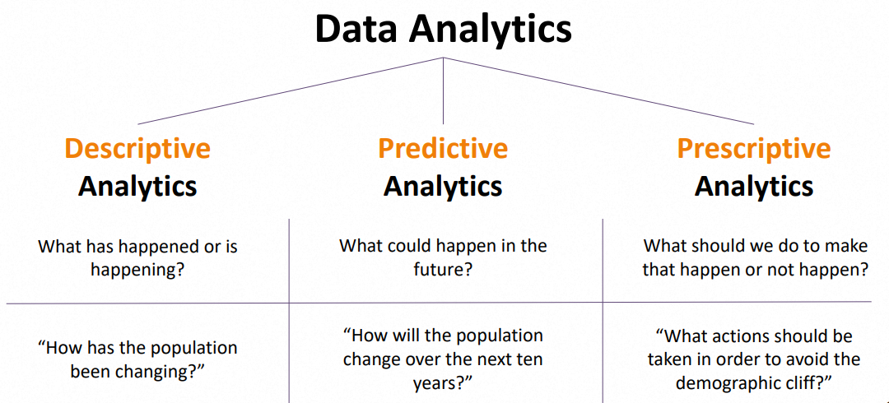

Slide 11
APPLICATIONS
Credit scoring
Market basket analysis/recommender systems
Retention Modeling/churn prediction
Response modeling
On-line Analytics
Social Media Analytics
Social Network Analytics
Fraud Analytics
HR Analytics
Process Analytics

Slide 12
DATA MINING APPLICATIONS
Market segmentation is used in data mining in order to identify the common characteristics of customers who buy the products from one’s company.
With market segmentation, you will be able to find behaviors that are common among your customers. As a company seeks customer’s trends, it helps them find necessities in order to help them improve their business.

Slide 13
DATA MINING APPLICATIONS
Customer churn predicts which customers will have a change of heart
towards your company and join another company (competitor). Although customer churns are negative to one’s business, it allows the corporation to seek out the problem they are facing and create solutions.
Market basket analysis- involves researching customer characteristics in respect to their purchase patterns

Slide 14
DATA MINING APPLICATIONS
Concept clustering - determines clusters according to attribute similarity.
Consider the pattern a purchase of toys for age group 3–5 years, is followed by purchase of kid’s bicycle within 6 months about 90% of the time by high income customers, which was discovered by data mining. The Company can identify the prospective customers for kid’s bicycle based
on toy purchase details and adjust the mail catalog accordingly.

Slide 15
DATA MINING APPLICATIONS
Deviation analysis, A deviation can be fraud or a change. In the past, such deviations were difficult to detect in time to take corrective action. Data mining tools help identify such deviations .
For example, a higher than normal credit purchase on a credit card can be a fraud, or a genuine purchase by the customer. Once a deviation has been discovered as a fraud, the company takes steps to prevent such frauds and initiates corrective action

Slide 16
PYTHON FOR DATA SCIENCE
INTRODUCTION TO LIBRARIES

Slide 17
Overview of Python Libraries for Data Scientists
Reading Data; Selecting and Filtering the Data; Data manipulation, sorting, grouping, rearranging
Plotting the data
Descriptive statistics
Inferential statistics

Slide 18
Python Libraries for Data Science
Many popular Python toolboxes/libraries:
NumPy
SciPy
Pandas
SciKit-Learn
Visualization libraries
matplotlib
Seaborn

Slide 19
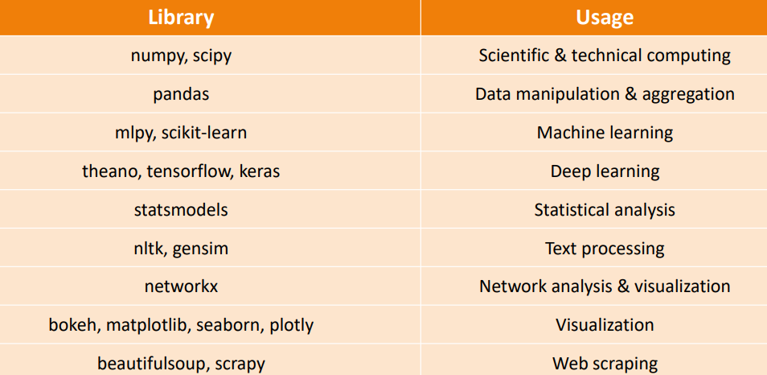
Python Libraries

Slide 20

Python Libraries for Data Science
NumPy:
introduces objects for multidimensional arrays and matrices, as well as functions that allow to easily perform advanced mathematical and statistical operations on those objects
provides vectorization of mathematical operations on arrays and matrices which significantly improves the performance
many other python libraries are built on NumPy
Link: http://www.numpy.org/

Slide 21

Python Libraries for Data Science
SciPy:
collection of algorithms for linear algebra, differential equations, numerical integration, optimization, statistics and more
part of SciPy Stack
built on NumPy
Link: https://www.scipy.org/scipylib/

Slide 22

Python Libraries for Data Science
Pandas:
adds data structures and tools designed to work with table-like data (similar to Series and Data Frames in R)
provides tools for data manipulation: reshaping, merging, sorting, slicing, aggregation etc.
allows handling missing data
Link: http://pandas.pydata.org/

Slide 23

Python Libraries for Data Science
SciKit-Learn:
provides machine learning algorithms: classification, regression, clustering, model validation etc.
built on NumPy, SciPy and matplotlib
Link: http://scikit-learn.org/

